Slide 1

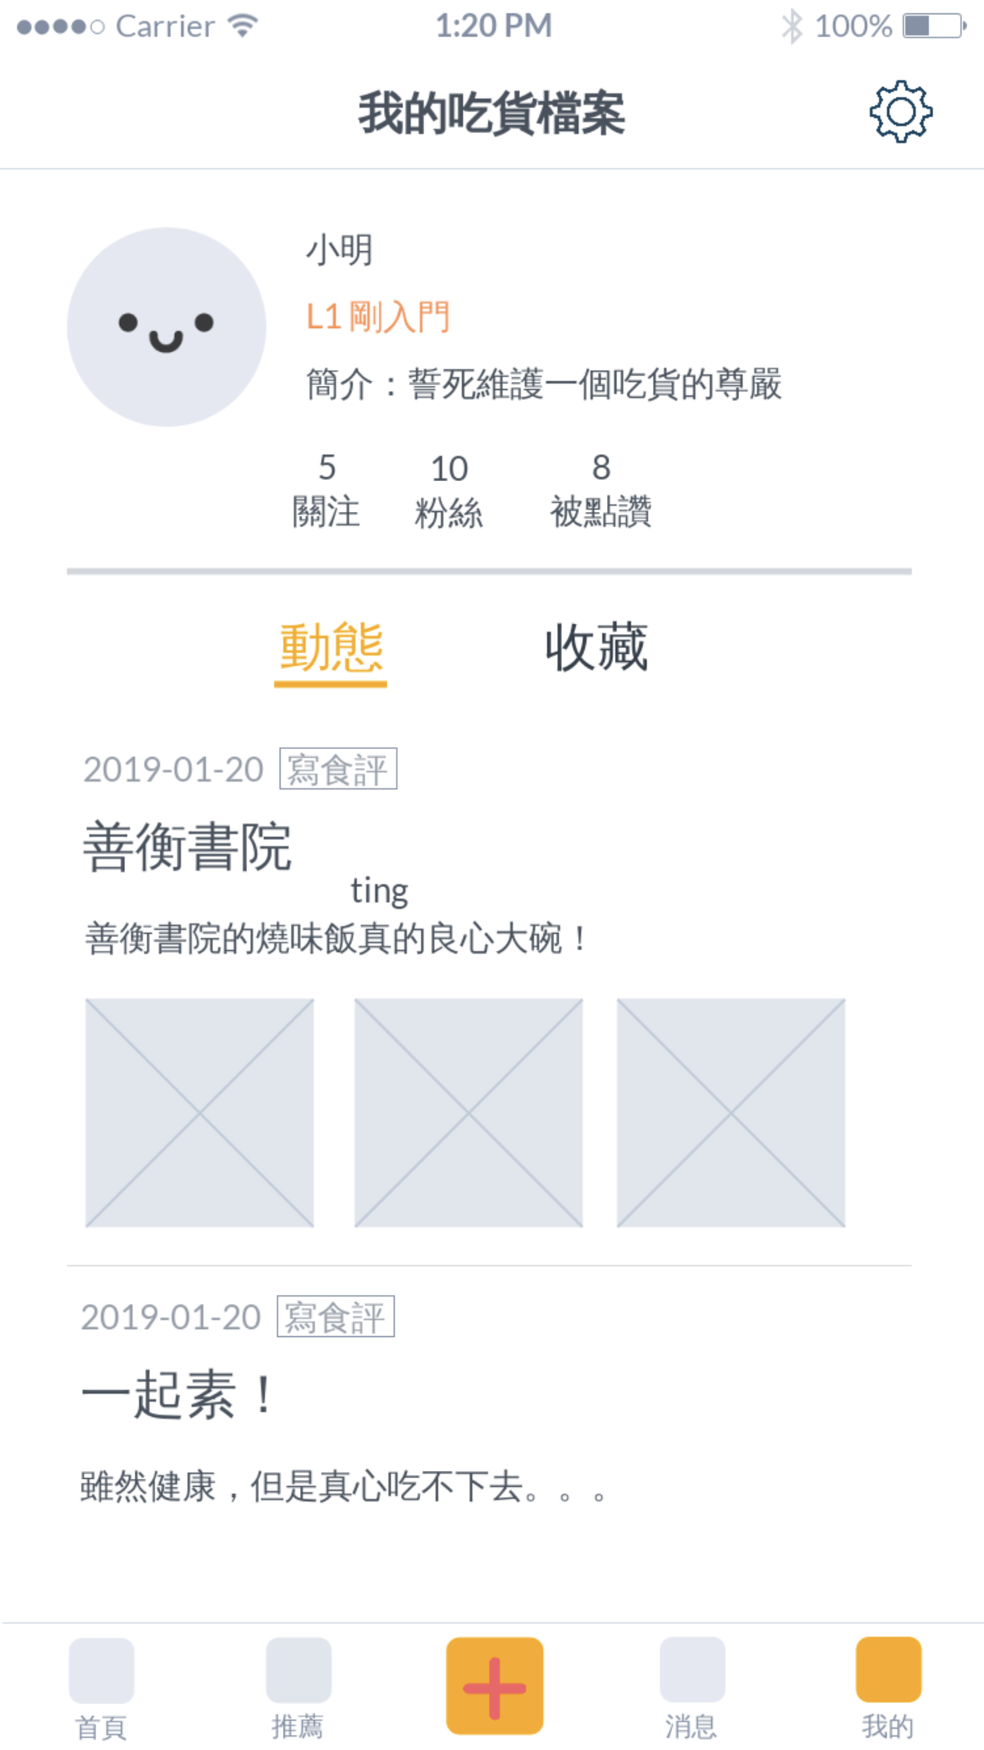
5. Personal homepage - Landing
Setting | General setting Edit profile
User profile | User name Level Bio Followed & Followers Liked
Activities | Users can check their past activities that a user have done on Foodbulous, like a diary Wrote food reviews (for now) In the future: Liked/saved others’ food reviews Marked restaurants ……

Slide 2
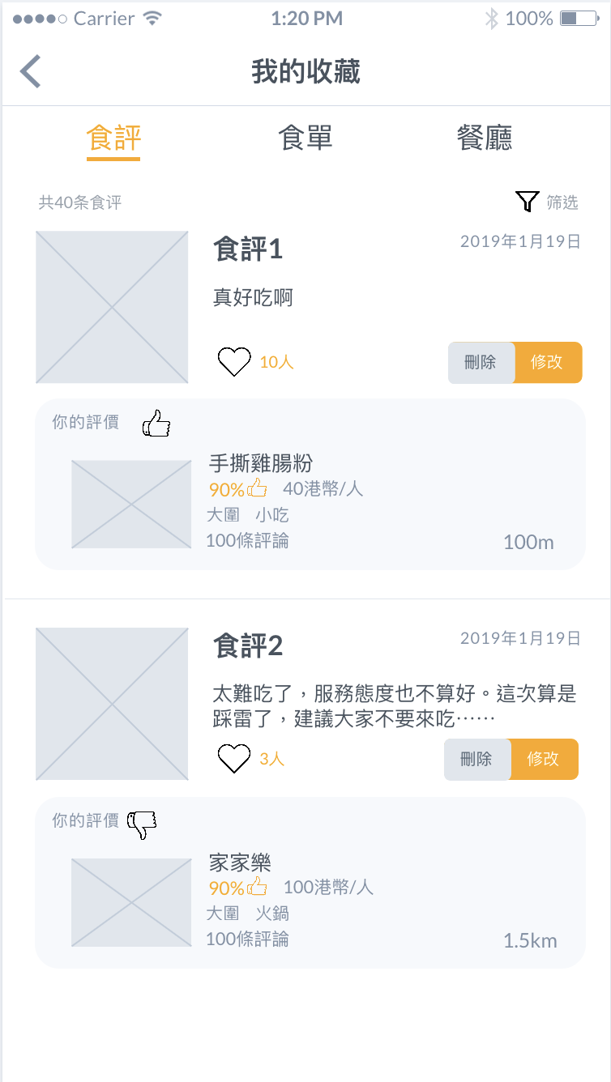
5. Personal homepage - My saved
Food reviews
Food reviews | Remind users that they are in the food review page
Images | The 1st photo that the user took
Food reviews excerpt | The title of the post The user’s reviews Excerpt length: 30 words
Restaurant profile card | The user’s attitude: like or dislike The restaurant’s name Total attitude Price per person Others’ reviews Distance
Other functions | Edit the food review if the user have changed his or her mind Delete the food review if the user regret color choose: Yellow for “edit” Gray for “delete” encourage users to edit rather than delete
Future functions | Filter More preference Users can filter out can find their food reviews more conveniently.

Slide 3
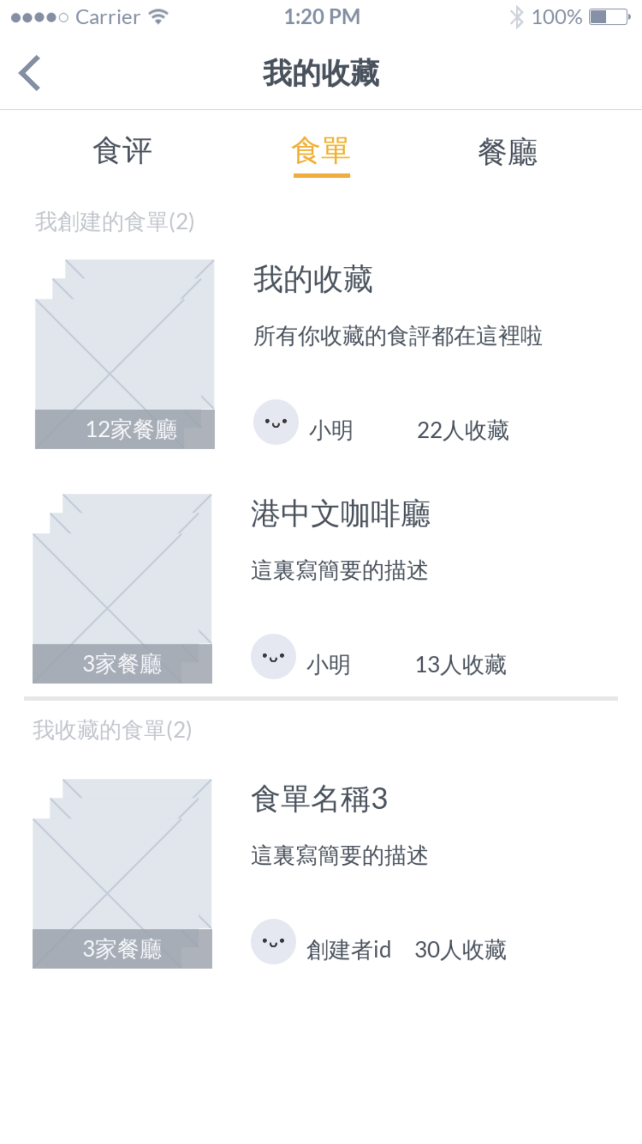
5. Personal homepage - My saved
Food list
Food list | Remind users that they are in the food list page
Created | The food lists that users own Either created by the system or by users
Default | Created by system Once a food review is saved by the user, it will be automatically stored in here It would help the users who are in busy and just want to save a food review and check it in the future.
Created | Created by users, more personalized The user could create food lists with different themes, and collect food reviews (their own or others) in each list.
Saved others | Created by others and saved by the users Because they are friends or they have the same taste, so the food reviews are more reliable and meaningful.
Preview | The selected photos The number of restaurants that mentioned in the food list
Other functions | See how many people save the food list

Slide 4
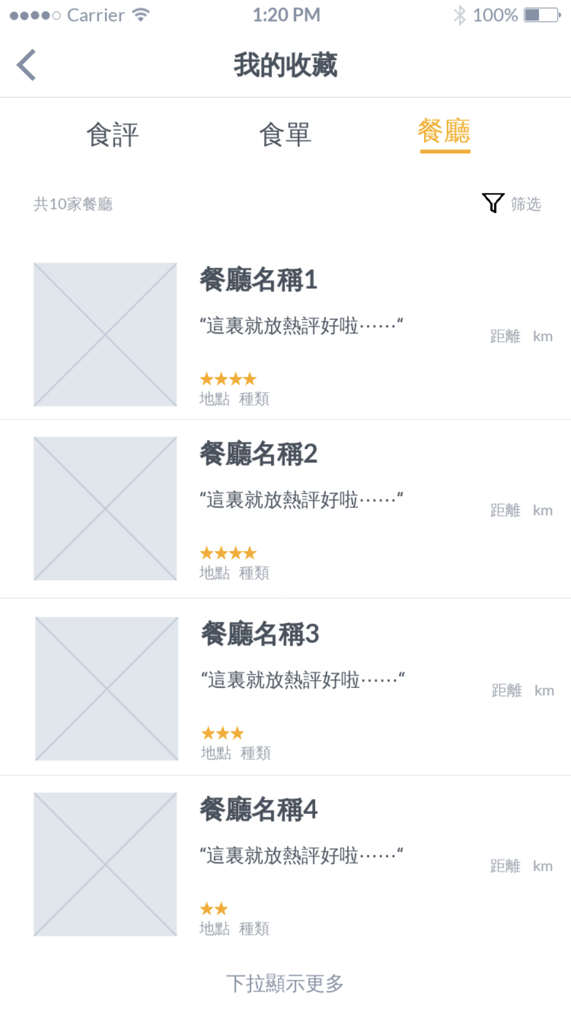
5. Personal homepage - My saved
Restaurants
Restaurants | Remind users that they are in the restaurants page
Restaurant profile card | Created by system Once a food review is saved by the user, the system will automatically store the restaurants it mentioned in here It would help the users quickly find the restaurants they have eaten / want to eat in the future.
Future functions | Filter More preference Users can filter out can find the restaurants more conveniently.

Slide 5
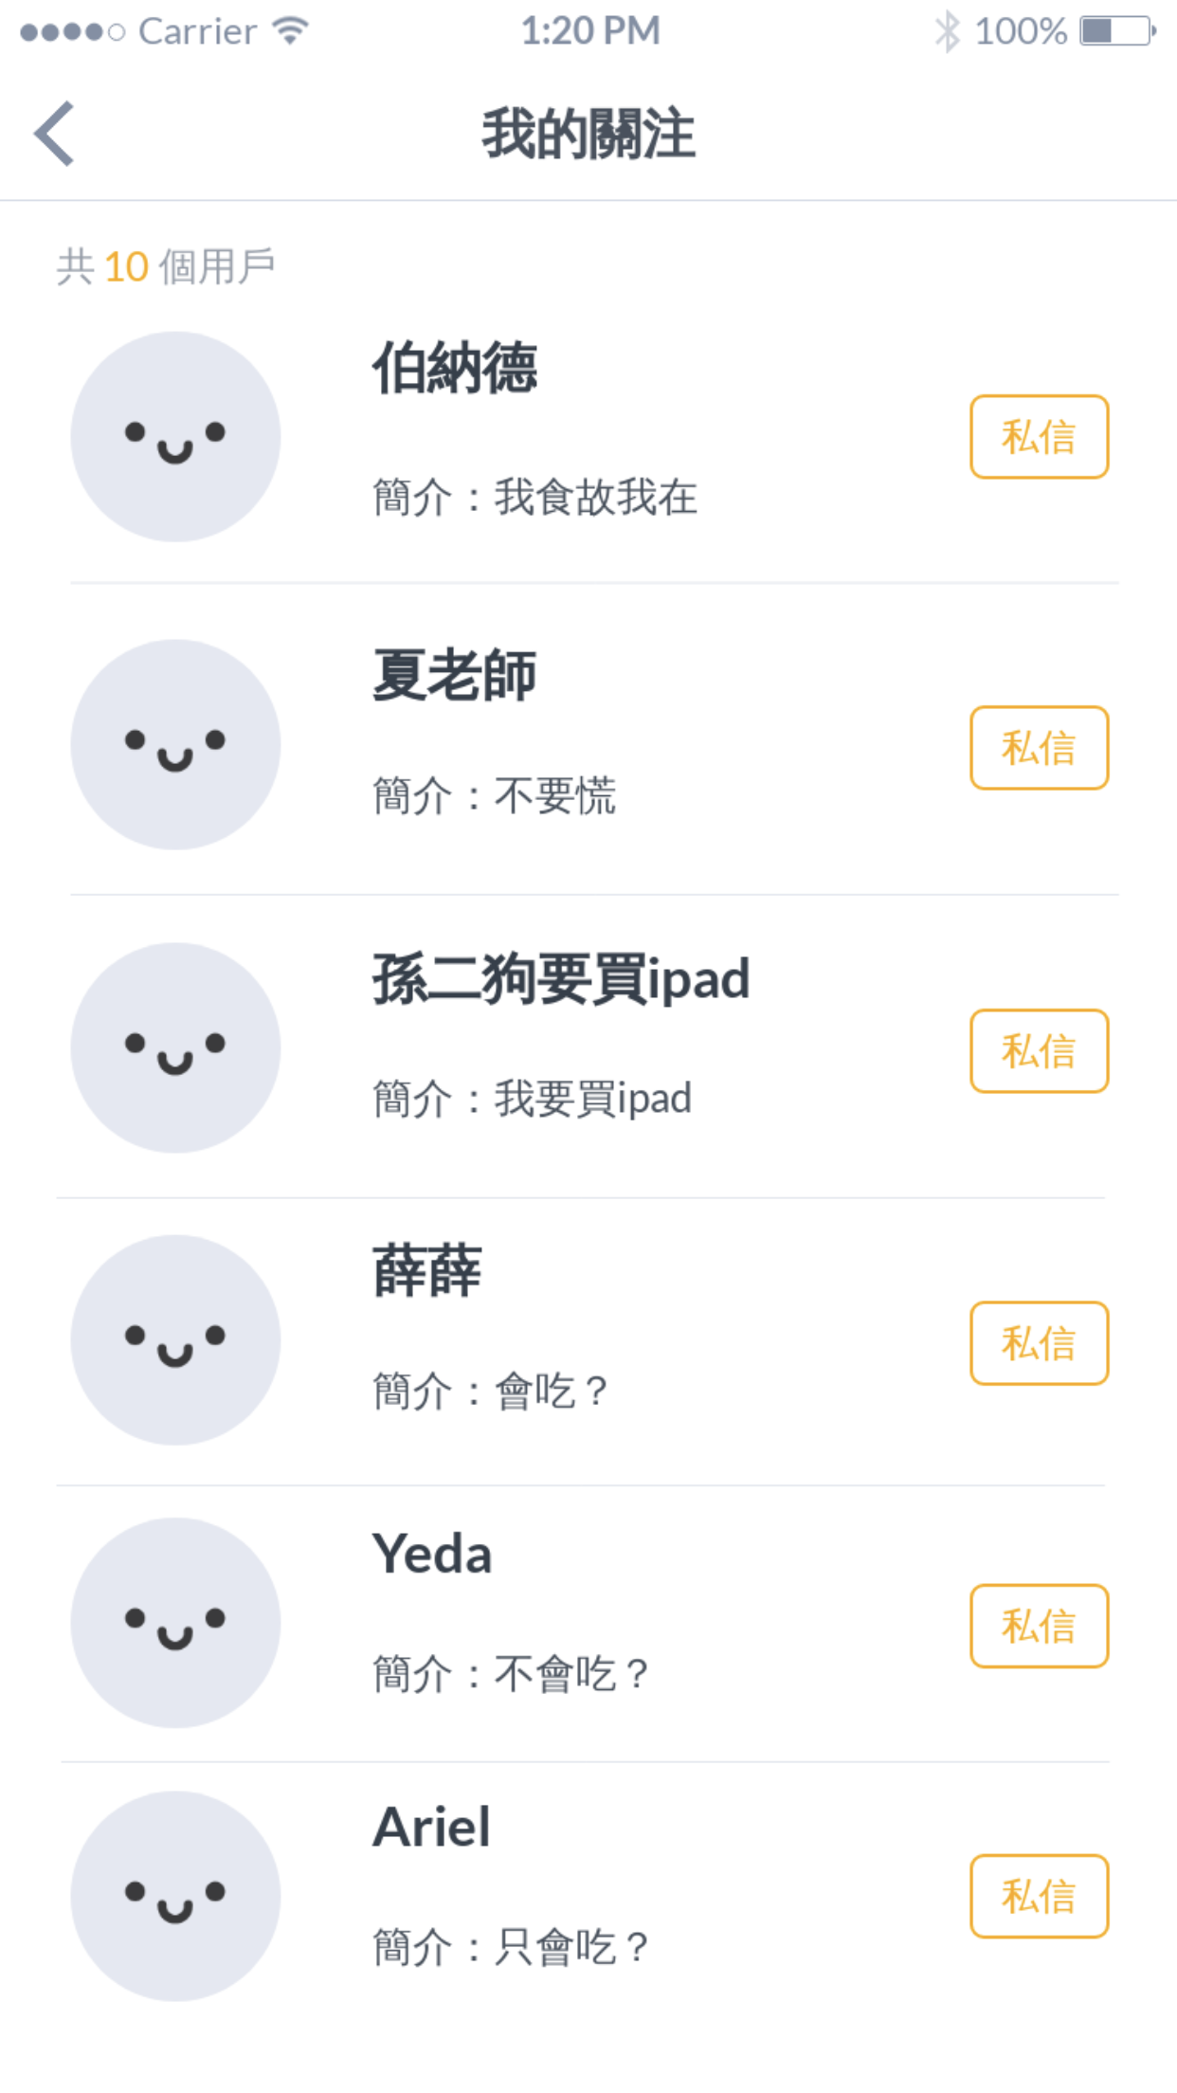
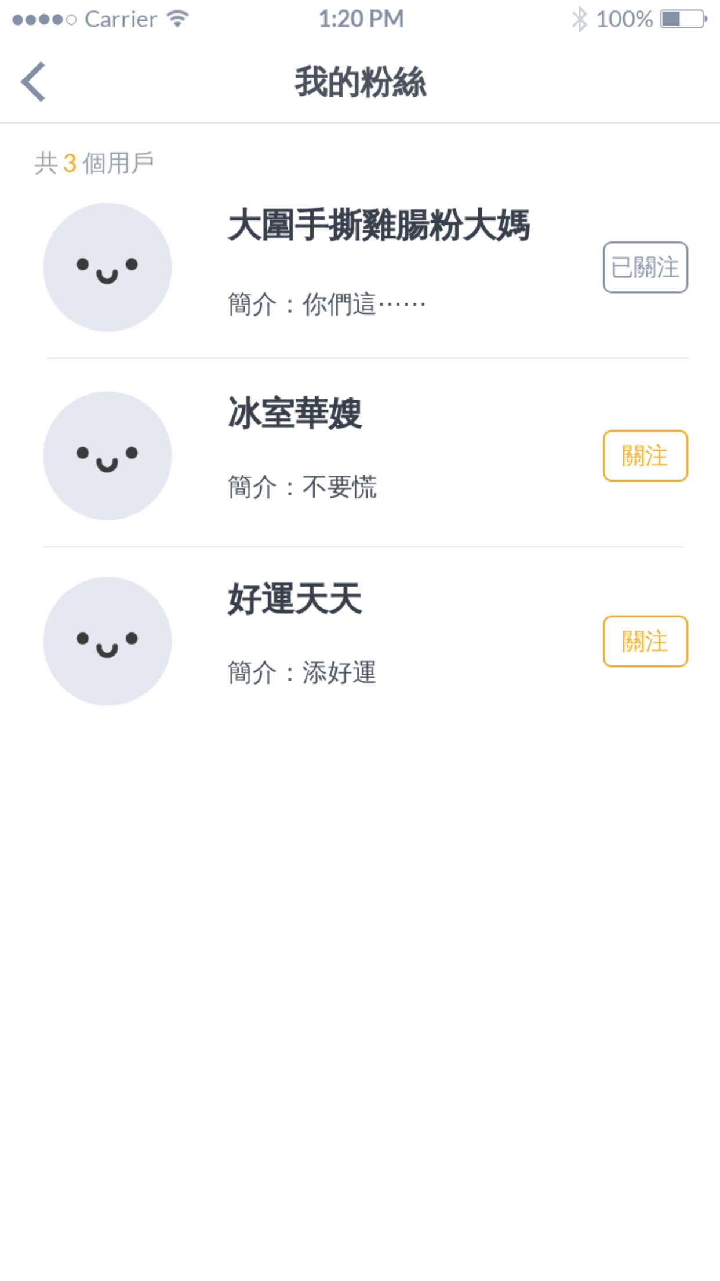
5. Personal homepage -Followed & Followers
Followed people | The number of people that the user followed
Followers | The number of followers
Message | “Yellow” button encourages users to contact with their friends
User Bio | User name Profile photo Bio
Follow back | “Yellow” button encourages users to follow back their followers “Grey” button means “already followed” and discourages users to cancel following Network effect

Slide 6
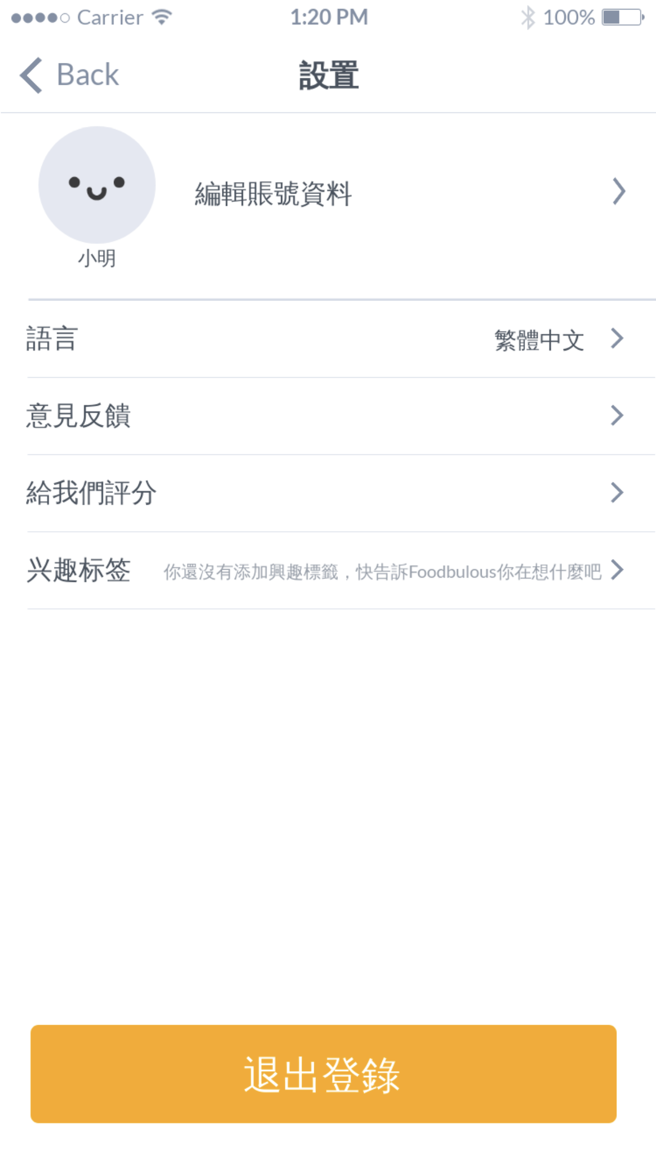
5. Personal homepage - General Settings
Edit profile | Click and edit personal profile
Language | Traditional Chinese Simple Chinese English
Feedback | Send feedback to the design team Help the team to improve the App better In the future: rewards to encourage users to send us feedback
Rating | Link to Apple Store
Tags | Choose the interests tags and let Foodbulous to know users better Related to personal recommendation on the homepages
Log out | Allow users to log out when they need After this, users can choose to login with the third social media or sign up with a new account.

Slide 7
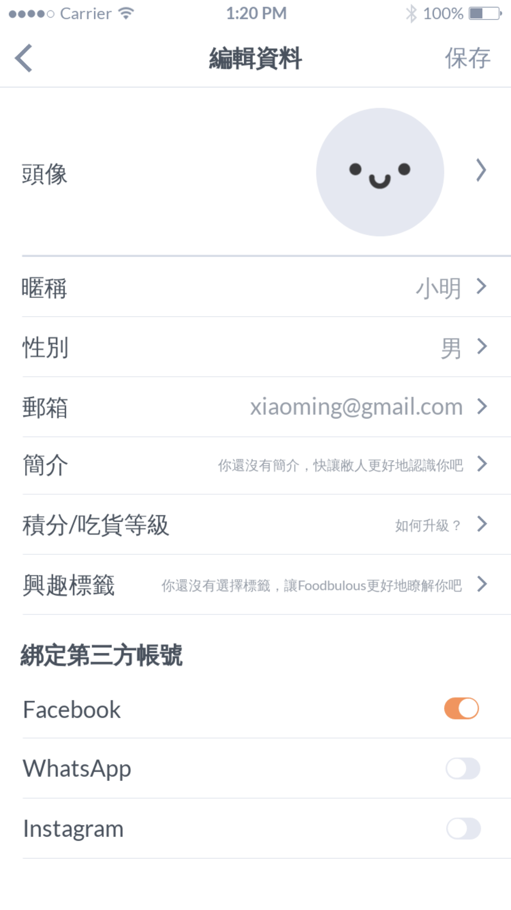
5. Personal homepage - General Settings
Photo | Change the profile photo
Basic profile | User name Gender Email Bio In the future: mobile phone number
Level | Gamification In the future: set the rules to higher level
Tags | Choose the interests tags and let Foodbulous to know users better Related to personal recommendation on the homepages
Third social media accounts | Link to other social media platforms See more friends Share activities More conversion rates

Slide 8
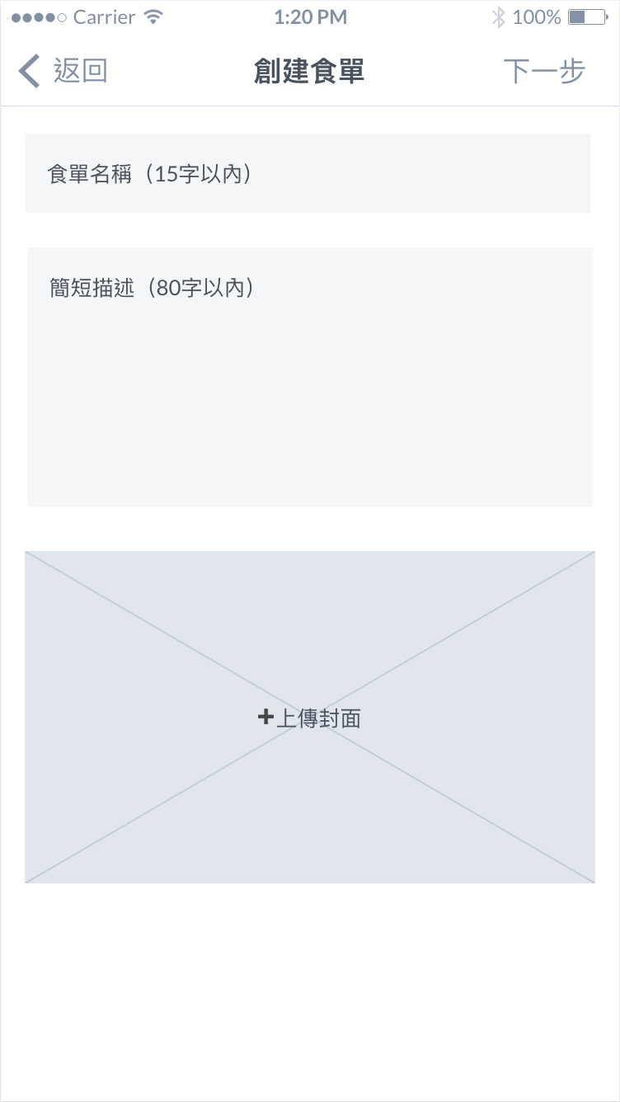
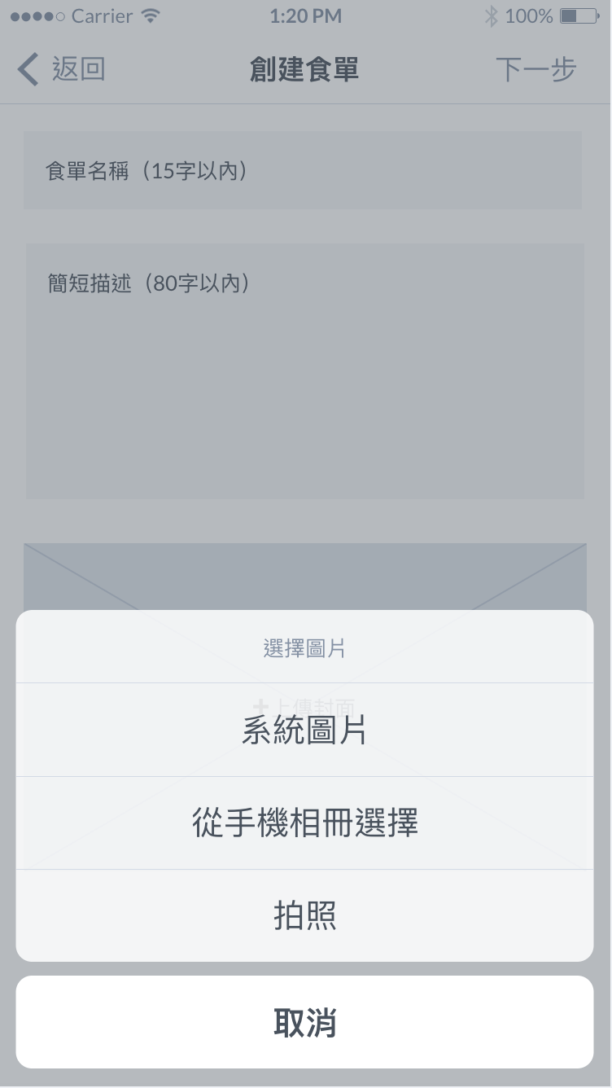
5. Personal homepage - Create a food list
Create food list
Upload the cover photo

Slide 9
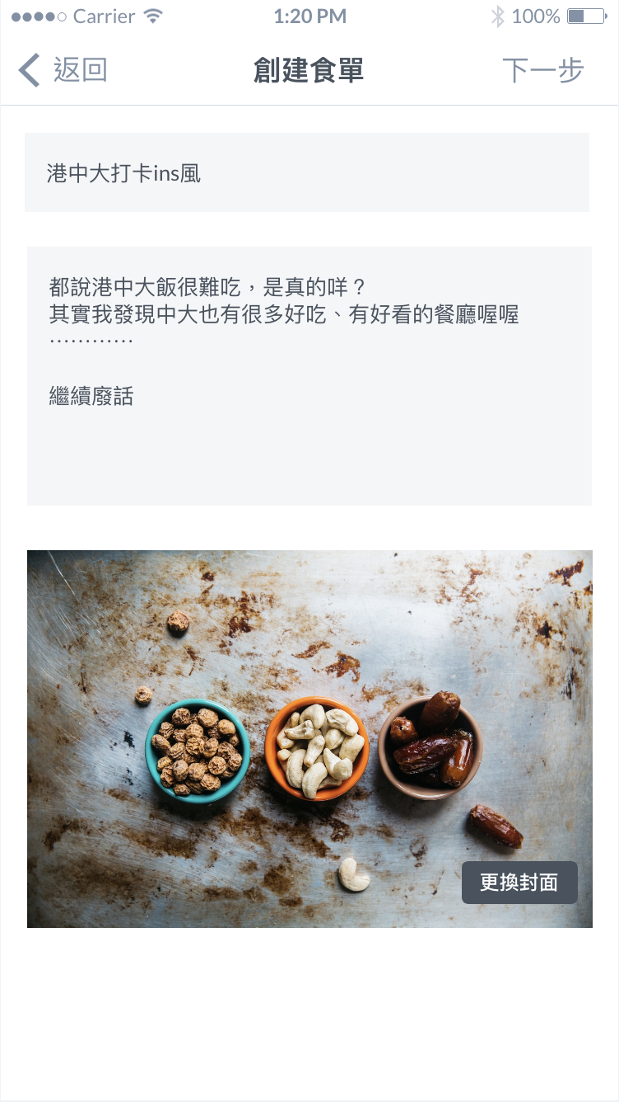
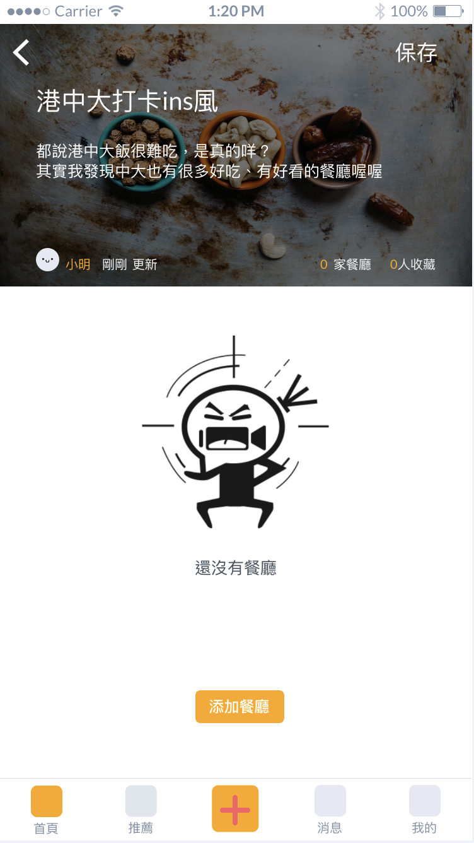
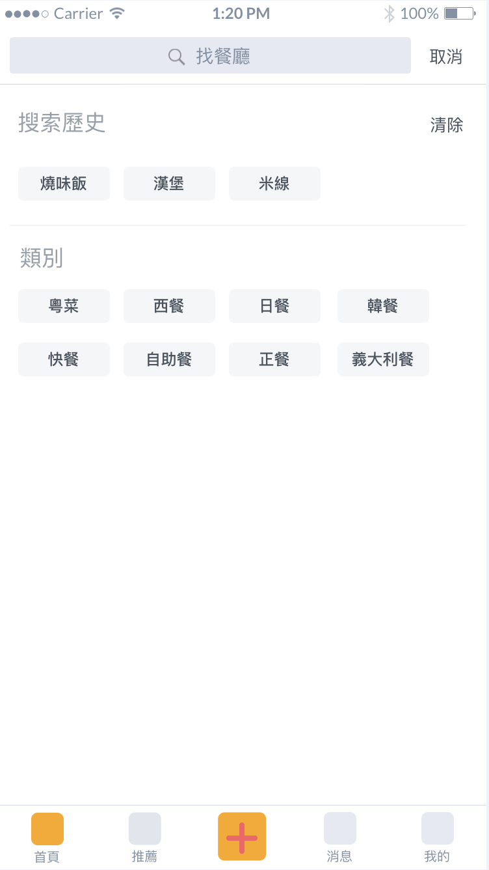
5. Personal homepage - Create a food list
Title | Create a title that match the preference
Introduction | A brief introduction about the list With limit of 100 words
Cover photo | Change the photo if the user doesn’t satisfy
Food list without food reviews and restaurants
Search food reviews or restaurants

